Slide 1
HOW-TO GUIDE FOR
SPECIAL EVENTS

Slide 2
Table of Contents
Why First Candle? 3 What Type of Event is Right for You 3 What First Candle Can Do to Help 4 Planning Your Event 4 Volunteers 4 Timeline 4 Budget 5 Obtaining Sponsors 5 Sponsorship Opportunities 5 FACT Sheet 6 The Ask 6 Promoting Your Event 7 Registration and Recruitment 7 Day of Event 8 Post Event 8 Wrapping Up 8 Feedback 9 Contacting First Candle Staff 9
Appendix 10
Sample Budget
Sample Donation/Sponsorship Request Letter Sample FACT Sheet
Sample Press Release Sample Final Event Report
2 | How-To Guide for Special Events

Slide 3
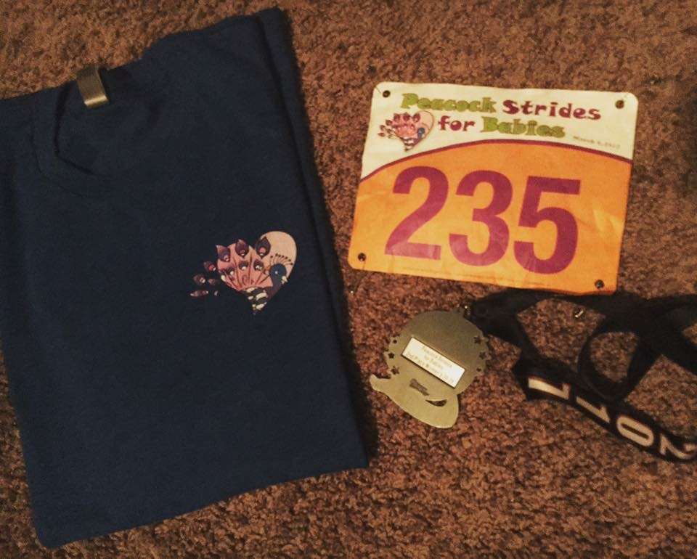
Why First Candle?
First Candle is a national nonprofit dedicated to infant health and survival. It is our goal to help ensure that every baby reaches not only his or her first birthday, but many happy birthdays beyond. Our focus includes Sudden Infant Death Syndrome (SIDS), Sudden Unexpected Infant Death (SUID) and preventable stillbirth. Every year nearly 30,000 babies die suddenly and unexpectedly in the U.S.; the U.S. infant mortality rates rank only 43rd in the world.
We can do better than that, you can help.
Special events are the lifeblood of our organization; we appreciate your interest in holding an event in your local community. As you will see in the pages that follow, we are committed to helping support your efforts and ensuring the proceeds go to our important research and education efforts.
Making the Decision
Many individuals have implemented special events in their communities for years and already have a clear vision of what their event will be and what it will include. If that is the case for you, that is terrific and you are probably already enjoying the fruits of your labor. However, many people are just beginning the special event process and have no idea where to start in planning a fundraising event. This guide is for you.
While deciding to plan a special event, you should answer the following questions:
1. What kind of event will it be? Following are some examples:
Peacock Strides for Babies
Golf Tournament
Walk-A-Thon
Scavenger Hunt
Auction (silent or live)
Benefit Concert
Bike-A-Thon
Dinner Dance
Bowling Tournament
Spinning Event
5KRun/Walk
First Birthday Party for a Healthy Baby
“Putting together the race helps us feel like we were still doing something for Emily. We could no longer change her diaper or feed her, but we were still working hard to make sure that other babies didn’t die from this mysterious killer. In total, the event has raised over $275,000 in eight years. The overwhelming response and support from our friends and community reminds us that people care. We will never be able to adequately express our gratitude to everyone.” ~The Ware Family
2. When and where will your event take place?
3. How much time do you and your volunteers have to dedicate to organizing the event?
4. How many volunteers will you need?
How-To Guide for Special Events | 3

Slide 4
What level of involvement do you expect from those assisting you?
How much money do you want to raise?
What is the potential to raise money?
What is the potential for publicity?
Think about each question thoroughly and consider all options before developing your plan. Brainstorming with potential volunteers is quite useful and can yield innovative ideas.
What First Candle Can Do To Help
First Candle is committed to helping your event be as successful as possible. In this regard, after you have completed and signed the Event Agreement, we are happy to provide each event captain with:
Encouragement and consultation by national staff experienced with special event fundraising;
Use of First Candle logo for your artwork;
Webpage development for donations and secure online registration for your guests;
Weekly registration and donation reports, including an event-day report the day before the event;
Use of Square Credit Card Readers to make credit card processing easy and paperless with your Smart Phone or Android;
Assistance with donor acknowledgments and thank you letters to event donors and participants
Use of First Candle’s 501c3 charity status to allow tax-deductible donations for donors;
Help in promoting your event through First Candle’s social media platforms.
Planning Your Event
Now that you’ve decided what your event will be, the planning stage begins. The success of your event will depend in large part on your ability to plan and be organized.
Determine how many volunteers you will need and who they will be. THIS IS IMPORTANT!
Create a Timeline: A timeline will be an invaluable tool as you work through the planning process. It should detail, from start to finish, the steps necessary to carry out your event. Your timeline should include the following items:
Category: What category does the task fall under (venue, food, etc.)?
Task: What needs to be accomplished (soliciting raffle items, etc.)?
4 | How-To Guide for Special Events

Slide 5
Deadline: When does the task need to be completed?
Responsibility: Who is in charge of this task?
Contacts: Who else is involved with this step? Names and contact information for vendors, donors and anyone else involved with the event should be included.
Notes: Any other information you feel is pertinent.
Remember, anyone should be able to pick up your timeline and understand clearly what needs to be accomplished and by when.
Determine if there are any permits or licenses that have to be pulled.
Check community calendars to be sure there is not a date conflict with another event.
Prepare a Budget. This is an important step but can be challenging, especially if this is your first event. We encourage you to be as realistic as possible when creating your budget so there are no surprises when calculating your final income and expense report! Feel free to refer to the sample budget worksheet provided on the following page.
Important note: Because we are a nonprofit organization and accountable to our donors, it is critical that your expenses not exceed 25 percent of your income (less if at all possible). This is considered to be the national standard by which First Candle is held accountable.
With a clear concept of the timeline and financial plan your event will follow, it is time to schedule a meeting with your volunteers to go over these documents!
Obtaining Sponsors
One misconception in planning a special event is that securing a company in your community to sponsor your event is impossible. Many people are intimidated by the thought of approaching local businesses and, as a result, may end up selling themselves and their event short. In this section, we describe ways to approach local businesses so you BOTH benefit.
Why Companies Become Sponsors:
Special events provide an opportunity for companies to portray themselves as civic-minded within their communities. Your event could be the perfect way for them to do this. Companies sponsor fundraisers for:
Publicity: The publicity your event generates for companies is probably the most valued benefit of sponsorship.
A Positive Image: Participating in your event will create a positive image for employees, colleagues and customers.
Positive Client Relations: Sponsorship can provide the opportunity to entertain potential clients or key constituencies at your event.
What Companies Look for in Event Sponsorship:
Does the event’s goal match the company’s philanthropic goals?
Can they trust the event will be executed responsibly and professionally?
How-To Guide for Special Events | 5

Slide 6
What will the benefits of their sponsorship be? (Signs, t-shirts, etc.)
Who are the participants in the event?
How many people will be there?
Could these participants be future clients or customers?
Is there another event occurring in the community at the same time?
How many other sponsors are there?
The next step in obtaining sponsors is to clearly outline the levels of sponsorship, products and services you will need to make your event a success.
Still Singing
Develop different sponsorship levels and name them (Platinum, Gold, Silver, etc.).
Determine the dollar amounts and benefits for each level.
Include a list of the products and services you will need.
“We both love music and the message that we are still singing after losing Talon means that, while we will never forget, we do find ways to carry on. We had an amazing night and raised money for a great cause close to our hearts, First Candle.” ~The Meyer Family
In addition to this Sponsorship Opportunities document, you should also create a FACT Sheet for your event. This document contains the Who, What, When, Where and Why (emphasize the Why!) of your event; include your personal story and a picture of your baby if possible. Potential
sponsors are very busy and can often only spare a few minutes to consider
your request. Having these two documents handy to leave behind can be very helpful.
If you are feeling creative, design a logo and/or letterhead for your event. This is optional, but may be a nice touch!
Now you are ready to start soliciting! Making requests in person is best, but you can also write a donation/ sponsorship request letter if it will allow you to reach more potential sponsors. When writing a letter, here are some things to keep in mind:
Whenever possible, use your connections. Even contacting a friend of a friend is better than making a cold call.
Be sure you are talking with the appropriate person to make a sponsorship or donation decision, or someone who is in a position to get it into the right hands.
Don’t forget to make your request a personal one. If you are a bereaved parent, talk about your
baby and why you are having this event. The company will want to know that their money will make a difference.
If someone at a company has been extremely helpful to you, capitalize on it. Do not feel that you are asking too much if they can provide great networking opportunities. This person could turn into a great champion of your efforts year after year.
6 | How-To Guide for Special Events

Slide 7
Promoting Your Event
At this point, the large pieces of your event are starting to come together. You should have the date, time and location of your event secured, as well as some sponsors and in-kind donations from community businesses. Now it’s time to start letting everyone know about this great event you’ve planned!
Ideally, every radio and television station in your area would be promoting your event frequently. The key is to be persistent and begin by building relationships with local media representatives. A sample press release is provided for your use. Usually, these stations have a Public/Community Relations department. Start there to determine the stations interest in promoting your event. At the very least, get your event listed on the Community Event Calendar.
Your local newspaper or news station may be willing to do a feature article on your event. Pitch it using you baby’s story. You should also, create flyers to distribute throughout your community. Be creative and use color. (This would be a great in-kind donation from a printer or graphic design company.) Remember, the more people in your community that are involved with and reminded of your event, the more people will come.
Registration and Recruitment
This is where First Candle can really help! Our experts can manage the financial aspect of your event. We can help set up a web page where people can learn about your event, register and make donations. We will provide you with links to include with any recruitment efforts you will be utilizing. We can also provide you with detailed reports throughout the registration process as well as final report the day before the event (or whenever you would like it.)
If you choose to handle registration yourself, be sure to be clear in your recruitment materials of the date, location, time and process they should follow to register.
Stephen Smith Family Fun Run
You should now be ready to begin recruiting participants! There are many tools you can use for this purpose:
“My husband Frank and I lost our son Stephen on April 24, 2013 while I was 29 weeks pregnant. We wanted to channel our grief and love for our son in a positive way by having a memorial run. We are now planning our 2nd annual event. One hundred percent
of the proceeds raised funded First Candle’s research and educational programs in 2014.”
~ The Smith Family
Distribute your FACT Sheet or Flyers. Libraries, supermarkets, community centers are good choices.
Set up a website for your event.
Email your family, friends, neighbors, co-workers, etc.
Use your Facebook page to spread awareness.
Involve First Candle! We are happy to promote your event on our calendar and social media platforms.
How-To Guide for Special Events | 7

Slide 8
Day of the Event
This is when your planning will finally pay off! The volunteers you have recruited and assigned responsibilities will be key to your success. Arrive early to ensure everything is set up and ready to go. If you have requested Square Readers from First Candle (credit card processors), have everyone using them do a test the night before to be sure they are working properly.
Post Event
Don’t breathe a sigh of relief yet! Post event activities can be just as challenging as the planning. Tying up loose ends such as auction items, phone calls, returning borrowed items and securing all promised funds are a few things to think about.
Wrapping Up
This final section is to be used after you have held your event. These important final steps include:
Scheduling a meeting with your volunteers to talk about all the things that went well and the things that could be improved for next year.
Decide if this will be an annual event. Don’t forget, the first year is always the most difficult.
For those that were extremely helpful in organizing your event, you may want to buy an inexpensive but thoughtful thank-you gift. This shows you did not take their help for granted.
Complete a Final Event Report. This is a very important last step. We ask that you please complete this report and return it to us within 30 days following the completion of your event. A sample is provided in the Appendix.
A terrific and heart-felt thank-you letter may make the difference for sponsors and donors to continue their support for next year. First Candle is available to help with your thank you letters and tax-receipts. Just send us a list (including addresses) of those you would like acknowledged.
8 | How-To Guide for Special Events

Slide 9
Feedback
Provide feedback to those who supported your event. Companies will want to know that your event was successful and that their sponsorship was critical to its success. The following are some ways to provide feedback to your sponsors:
If you have received positive letters or comments, share them with your sponsors, donors and volunteers.
Provide pictures of the event to the sponsors (even if they attended the event), especially the photos that feature their company logo or employees.
Send copies of any newspaper articles about the event to your sponsors.
Offer to take the sponsors to lunch to thank them again for being a champion of your cause. Give them the opportunity to ask questions and discuss the possibility of their sponsorship next year.
The last impression that you give to all those who contributed to or were involved with your event is crucial to your organization’s credibility and to obtaining their help in the future.
Questions and Comments for First Candle Staff
We hope that you have found this guide to planning a special event beneficial to you and your volunteers. However, we know that questions may arise that this guide has not covered.
If you have any questions, concerns or general comments, feel free to contact Linnea Michaels at linnea@firstcandle.org or 203.966.1300.
First Candle staff will be there with guidance and suggestions as well as encouragement for all the wonderful things you are doing for the benefit of infant health and survival.
Best of luck in your fundraising efforts!
How-To Guide for Special Events | 9

Slide 10
APPENDIX
Sample Budget
Sample Donation/Sponsorship Request Letter Sample FACT Sheet
Sample Press Release Sample Final Event Report
10 | How-To Guide for Special Events

Slide 11
Sample Budget
INCOME
Registration Fees (money charged to participate)
Donations (gifts received in memory of the baby)
In-Kind Products and Services (food, beverage, PR)
Sponsorships (companies, businesses that contribute at various levels to offset expenses)
TOTAL INCOME
EXPENSES
Facility Rental
Equipment Rental
Food/Beverages
Supplies
Advertising/Printing/Promotions
Postage
Travel
Insurance/Licenses
Professional Fees/Contracted Labor
Gifts/Prizes/Awards
Miscellaneous
TOTAL EXPENSES
NET INCOME
Reminder: It is important to be sure your expenses do not exceed 25 percent of your income! Ten percent would be the gold standard to strive for!
How-To Guide for Special Events | APPENDIX

Slide 12
Sample Donation/Sponsorship Request Letter
[Insert Name and Address]
Dear [insert name]:
I am writing today to request your support for an important local event. Your sponsorship would be a critical component of our success and an investment that you, your company and its employees could be proud of.
As you may be aware, SIDS is the number one cause of death for infants one month to one year of age, claiming 2,300 babies in the United States each year. Historically SIDS has been a mystery, leaving behind devastated families and bewildered physicians. Today, we are beginning to find some answers . . . such as factors that increase the risks for SIDS and actions that parents can take to reduce those risks.
OR
Did you know that more than 26,000 babies are stillborn in the U.S. each and every year? The majority of these deaths occur during the last trimester to otherwise healthy babies and little is being done to find out why. Much more research needs to be done if we are to identify potential causes and/or cures for stillbirth; your help is needed to give parents the answers they deserve.
The proceeds from this event will support the important programs and services at First Candle. This wonderful organization is working to ensure that every baby is given the best possible chance to reach his or her first birthday healthy and safe.
Enclosed you will find the details of this event and various sponsorship opportunities available. I thank you in advance for your kind consideration of my request. Please feel free to contact me at [insert number] with any questions you may have.
Sincerely,
[Insert Name] Event Chairman
APPENDIX | How-To Guide for Special Events

Slide 13
Sample Event Fact Sheet
On January 6, 2004, our family suffered the tragedy of losing the youngest member of our family, Clayton Paul Haley, a much beloved little boy and the world’s next Motocross Champion, to Sudden Infant Death Syndrome (SIDS).
Clayton was a perfectly healthy baby, as are all 2,300 infants lost to SIDS each year. In an effort to do some- thing proactive and positive in Clayton’s memory, my family is proud to announce the 18th Annual Clayton Paul Haley Memorial Motocross Race. All proceeds from the event will benefit the programs and services of First Candle, the nation’s leader in the field of infant health and survival.
When: Saturday, September 18 & Sunday, September 19, 2004
Where:
Hidden Valley MX Track Burlison, Tennessee
Cost: $10 and $30 per class to race Details of the Motocross Event:
Fast 1.8 mile Texas style national outdoor track;
Very fast and safe track ;
Great 40 rider backward falling starting gate;
Track was completely new in 2000, new sections and improvements have been made every year;
Designed and built by Trey Clingfrost, owner/operator of Swan Cycle Park;
Gates will open at 6 a.m.;
Sign-up starts at 7 a.m.; and
Practice will begin at 9 a.m. and racing will immediately follow.
First Candle is a national nonprofit health organization uniting parents, caregivers and researchers nationwide with government, business and community service groups to advance infant health and survival.
It is their mission is to promote safe pregnancies and the survival of babies through the first years of life. This is accomplished with programs of research, education and advocacy, while at the same time providing compassionate grief support to those affected by the death of a baby.
Clayton Paul Haley [photo] 9/15/03 – 01/06/04
For more information about Clayton’s Event contact [event chair info]. For more information on First Candle, contact Linnea Michaels at linnea@firstcandle.org or 203.966.1300.
How-To Guide for Special Events | APPENDIX

Slide 14
Sample Press Release
Contact: [event captain name] [Phone], [Email Address]
For Immediate Release
Local Event Helps Babies Survive and Thrive [Name of Event] to be Held [enter date]
[City, State – Month, Year] In an effort to create awareness and raise funds to support the fight against Sudden Infant Death Syndrome (SIDS) OR Stillbirth and other causes of sudden infant deaths, (name of person/family/org) will be sponsoring a fundraising event for (city or town name) residents and their
families. (name of event) will take place at (name of facility or venue), (address), on (date of event). Tickets are (cost) and can be purchased (when, where). All proceeds will be donated to First Candle in support of their important programs and services.
[Enter an emotional quote from you or other official organizer of the event here]
This event will be dedicated to the memory of all babies in (enter state or city), who have died of suddenly and unexpectedly, in hopes of finding a cause and/or cure for these tragic causes of infant death.
For more information, contact [enter contact person information].
###
About First Candle: First Candle is a leading national nonprofit dedicated to safe pregnancies and the survival of babies through the first years of life. With programs of research, education and advocacy, the organization is working to ensure that every baby is given the best possible chance to reach not only his or her first birthday, but many happy birthdays beyond. First Candle also provides compassionate grief support to all those affected by the death of a baby through a toll-free crisis hotline (1.800.221.7437). For more information or to make a donation, please visit www.firstcandle.org or call 203.966.1300.
APPENDIX | How-To Guide for Special Events

Slide 15
Sample Final Event Report (due within 30 days following your event)
Please adjust your income and expense according to your event.
Name of Event:
Event Captain:
Location of Event:
Date of Event:
How many years have you been doing this event?
In Memory of:
Income: | Cash Checks Online Donations/Registrations In-Kind Products and Services Sponsorships
Total Income:
Expenses: | Facility Rental Equipment Rental Food/Beverages Supplies Advertising/Promotion Printing/Postage Insurance/Certifications Gifts/Awards Miscellaneous
Total Expenses:
NET INCOME:
How-To Guide for Special Events | APPENDIX

Slide 16
Additional Important Information:
What Facebook or website links did you use to promote your event?
Did you get any media coverage that helped make the event powerful?
Do you have any learning experiences you would like to share?
Will you be doing this event next year?
Any other comments that you would like to share?
Thank you! Please email or mail your report to Linnea Michaels, linnea@firstcandle.org, or First Candle, 49 Locust Ave., Suite 104, New Canaan, CT, 06840, attention Tori Brown.
Be sure to include all outstanding checks and names/addresses of those you would like thanked.
APPENDIX | How-To Guide for Special Events

